Slide 1
Data Structures

Slide 2
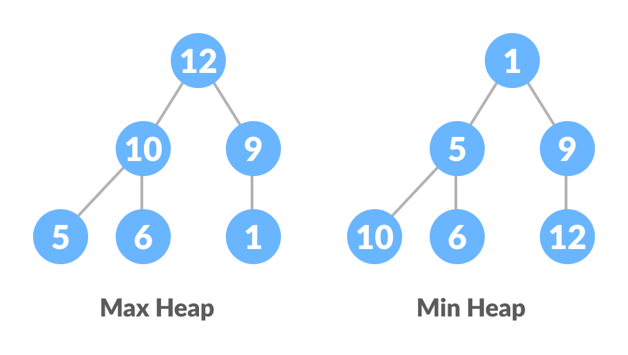
Heap/Binary Heap Data Structure
Heap data structure is a complete binary tree that satisfies the heap property, where any given node is
always greater than its child node/s and the key of the root node is the largest among all other nodes. This property is also called max heap property.
always smaller than the child node/s and the key of the root node is the smallest among all other nodes. This property is also called min heap property.

Slide 3
Heap Data Structure
Heap is a special tree-based data structure. A binary tree is said to follow a heap data structure if
it is a complete binary tree
All nodes in the tree follow the property that they are greater than their children i.e. the largest element is at the root and both its children and smaller than the root and so on. Such a heap is called a max-heap. If instead, all nodes are smaller than their children, it is called a min-heap
The given diagram shows Max-Heap and Min-Heap.

Slide 4
Binary Heap
A Binary Heap is a complete Binary Tree which is used to store data efficiently to get the max or min element based on its structure.

Slide 5
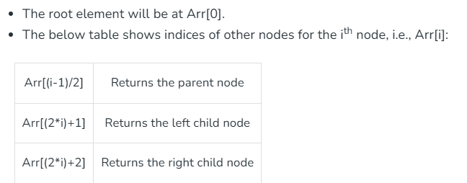
How is Binary Heap represented?
A Binary Heap is a Complete Binary Tree. A binary heap is typically represented as an array.

Slide 6
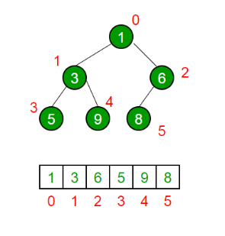
How is Binary Heap represented?
The traversal method use to achieve Array representation is Level Order Traversal

Slide 7
Heap Operations
Below are some standard operations on min heap:
getMin(): It returns the root element of Min Heap. The time Complexity of this operation is O(1). In case of a maxheap it would be getMax().
extractMin(): Removes the minimum element from MinHeap. The time Complexity of this Operation is O(log N) as this operation needs to maintain the heap property (by calling heapify()) after removing the root.
decreaseKey(): Decreases the value of the key. The time complexity of this operation is O(log N). If the decreased key value of a node is greater than the parent of the node, then we don’t need to do anything. Otherwise, we need to traverse up to fix the violated heap property.
insert(): Inserting a new key takes O(log N) time. We add a new key at the end of the tree. If the new key is greater than its parent, then we don’t need to do anything. Otherwise, we need to traverse up to fix the violated heap property.
delete(): Deleting a key also takes O(log N) time. We replace the key to be deleted with the minimum infinite by calling decreaseKey(). After decreaseKey(), the minus infinite value must reach root, so we call extractMin() to remove the key.

Slide 8
[35, 12, 50, 22, 60, 3, 90, 25, 17, 70, 45]
Create Max and Min heap of given array

Slide 9
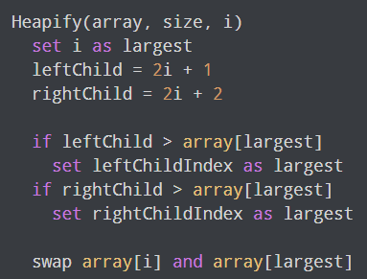
Heapify
Heapify is the process of creating a heap data structure from a binary tree. It is used to create a Min-Heap or a Max-Heap.
Algorithm
Let the input array be:
[3, 9, 2, 1, 4, 5]
Create complete binary tree

Slide 10

Heapify
To create a Max-Heap:
For Min-Heap, both leftChild and rightChild must be larger than the parent for all nodes.

Slide 11
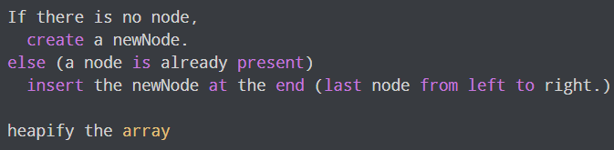
Insert Element into Heap
Algorithm for insertion in Max Heap
For Min Heap, the above algorithm is modified so that parentNode is always smaller than newNode.

Slide 12
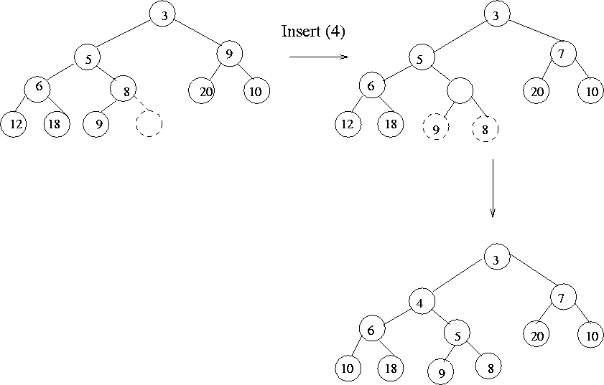
Insert Element into Heap
Algorithm:
Add the element at the end.
Compare with parent.
If heap property is violated, swap with parent.
Repeat until heap property is restored.
Time Complexity: O(log n)

Slide 13
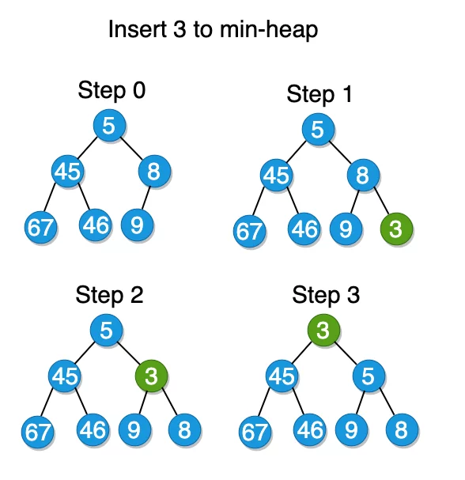

Slide 14
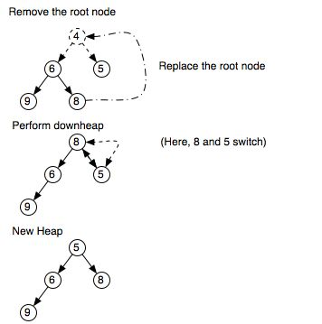
Delete Element from Heap
Algorithm:
Replace the root with the last element.
Heapify down from the root to restore heap property.
Swap with the larger (or smaller) child depending on Max-Heap or Min-Heap.
Time Complexity: O(log n)

Slide 15
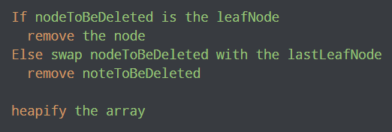
Delete Element from Heap
Algorithm for deletion in Max Heap

Slide 16
Peek (Find max/min)
For both Max heap and Min Heap
return root Node

Slide 17
Applications of Heaps:
Heap Sort: Heap Sort uses Binary Heap to sort an array in O(nLogn) time.
Priority Queue: Priority queues can be efficiently implemented using Binary Heap because it supports insert(), delete() and extractmax(), decreaseKey() operations in O(log N) time. Binomial Heap and Fibonacci Heap are variations of Binary Heap. These variations perform union also efficiently.
Graph Algorithms: The priority queues are especially used in Graph Algorithms like Dijkstra’s Shortest Path and Prim’s Minimum Spanning Tree.
Many problems can be efficiently solved using Heaps. See following for example. a) K’th Largest Element in an array. b) Sort an almost sorted array/ c) Merge K Sorted Arrays.

Slide 18
Reference
Page#268, Chapter#06 of Adam Drozdek
Heap Data Structure
Geek for Geek

